Slide 1

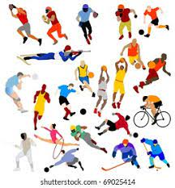


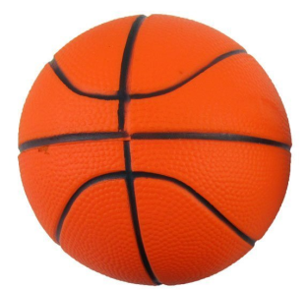

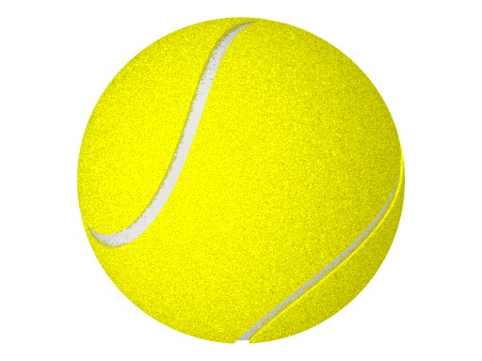
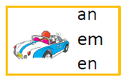


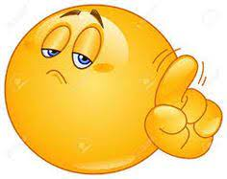
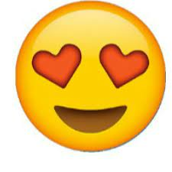
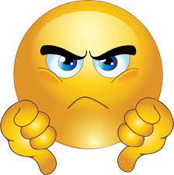
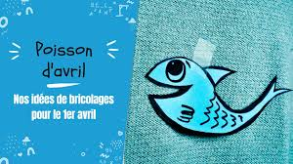
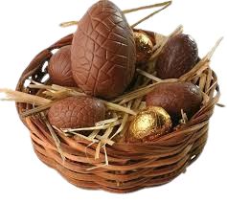
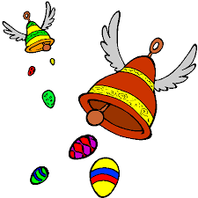
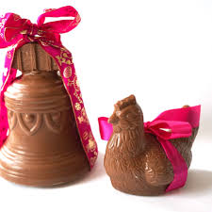
Sticky Knowledge : Sports
Year 4
Spring 2
Les sports – sports
How to say
I play + sport / I do + sport
Negative sentence in French
French phonics
Le football - football
Le rugby – rugby
Le cricket – cricket
Le basket - basketball
Le netball - netball
Le volley – volley-ball
Le tennis – tennis
Le ping-pong/tennis de table – table tennis
Le golf - golf
Le badminton - badminton
Le cyclisme – cycling
La natation – swimming
La danse – dance
La gymnastique - gymnastics
L’équitation - horse-riding
L’athlétisme - athletics
Le judo – judo
Le taekwondo – Taekwondo
Le skateboard - skateboarding
Use “je joue” with sports which are played with a ball or a racket.
Je joue au foot :
I play football
Je joue au tennis :
I play tennis
Think
Glasses
You need to add 2 words for negative sentence in French – NE & PAS
Je ne joue pas au football
Je ne fais pas de la natation
Use “Je fais” for sports for which you would say “ I do” in English
Je fais de la natation :
I do swimming
Je fais du cyclisme :
I do cycling
Telling what sports you do during the week
Opinions - Give an opinion
Le lundi je joue au foot
On Monday I play football
Le jeudi je fais de la natation
On Thursday I do swimming
Le weekend je joue au cricket
At the weekend I play cricket
Les jours de la semaine -
Days of the week
J’aime – I like
J’adore – I love
Je n’aime pas – I don’t like
Je déteste – I hate
C’est super – it is great
C’est cool – it is cool
C’est sympa – it is fun
C’est fatiguant – it is tiring
J’aime le rugby c’est cool ! I like rugby, it is cool
J’aime le cricket parce que c’est super – I like cricket because it is great
Lundi - Monday
Mardi - Tuesday
Mercredi - Wednesday
Jeudi - Thursday
Vendredi - Friday
Samedi - Saturday
Dimanche - Sunday
La semaine – the week
Le lundi – On Monday
Le weekend – at the weekend
COGNATES : A word that looks similar or sounds similar in 2 languages and means the same
TRICKNATES : A word that looks similar or sounds similar in 2 languages but IT DOES NOT MEAN THE SAME !
Easter Traditions in France – Pâques
1st of
April in France
Le chocolat – chocolate
Le lapin – the bunny
Le poisson – the fish
La cloche – the bell
La tradition – tradition
L’oeuf – the egg
Le panier – the basket
Chocolat au lait – milk chocolate
Chocolat blanc – white chocolate
Chocolat noir – dark chocolate
la châsse aux oeufs – Easter eggs hunt
Les oeufs en chocolat – chocolate eggs

