Slide 1
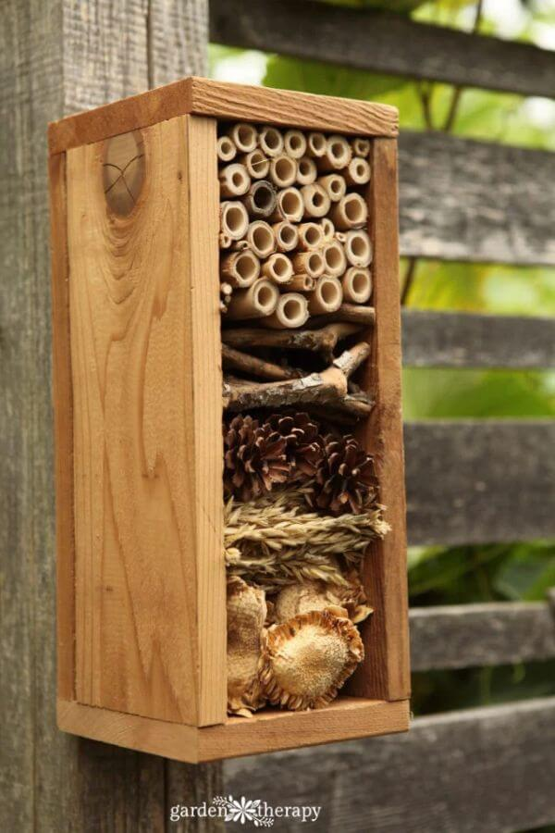
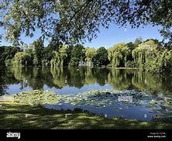
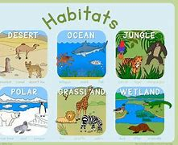

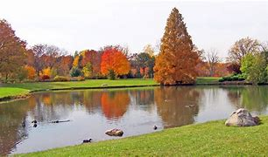
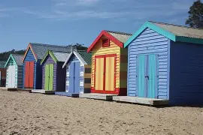
Places to visit:
Wildmoor Heath, Crowthorne
Shepherd Meadows and Sandhurst Memorial Park, Sandhurst
Trilakes Country Park, Sandhurst
When visiting these places, you can be
on the look out for different habitats,
any animals you can see and any plants
you think are interesting! Please bring in
pictures if you want to share!
Things to make and do:
You could create a bug hotel! (The instructions
are for a wooden box, but you can also use
cardboard to create this!)
https://gardentherapy.ca/build-a-bug-hotel/
Research different habitats and create a poster
about the animals that live there. For example,
what animals live in the desert?
Year 2 Family Learning Ideas
‘What a Wonderful World’
Research Ideas and Books to Share:
Research your local area. Is there any interesting history you can share with the class?
Any books about significant figures in History (non-fiction or fiction), for example, Neil Armstrong, Rosa Parks or Emmeline Pankhurst.
Can you find any non-fiction books about animals and their habitats? Are there interesting facts you can share with the class?
Beach Hut Locations: Find out where beach huts are popular in the UK (e.g., Brighton, Southwold) and mark them on a map.
Outdoor Learning:
Visit a local pond in your area. What plants can you see in the water? What animals can you see that live in the pond?
Go for a walk in your local area. Collect any interesting leaves, acorns or conkers that you find and add them to your bug hotel!
Go into your garden and investigate any bugs that live there. Where do you find them and what does their habitat look like?

