Slide 1
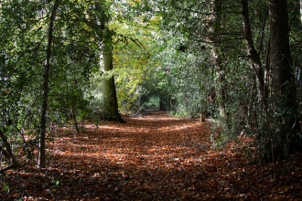
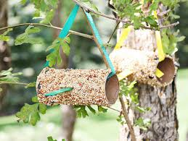
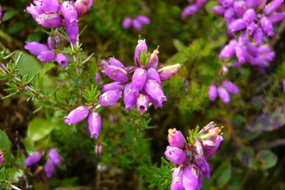
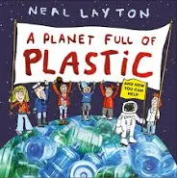

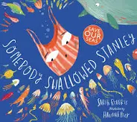
Places to visit:
Wildmoor Heath (Crowthorne)- nature reserve with insects, reptiles and all different plants.
Shepperlands Farm (Wokingham)- a meadow, wood and heath teeming with wildlife.
Poors Allotment (Camberley)- a haven for protected birds.
Things to make and do:
Are you able to feed the birds? Even in the winter, the birds need help to get their food, so could you make a bird feeder? An example can be found here:
https://playofthewild.com/2020/01/15/pinecone-birdfeeders-outdoor-learning-in-preschool/
Can you make a poster about all the things we can do to keep our Earth safe and healthy?
Year 2 Family Learning Ideas
‘Protectors of the Earth’
Research Ideas and Books to Share:
Any books based on looking after our environment or protecting the animals. Some examples are:
Outdoor Learning:
Make a list of all different animals that you might find in the woods (fox, rabbit, squirrel, birds). Go on a walk in the woods local to you, and see if you can spot all the animals!
On a walk in your local park, take a picture of a plant, tree or animal, and see if you can recreate the picture by sketching it and shading it yourself!
Nearer to Christmas, take a walk in your neighbourhood to see the Christmas lights- what do they symbolise?

