Slide 1
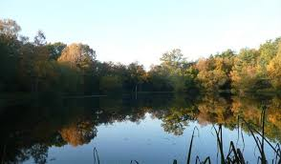
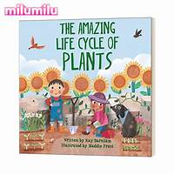
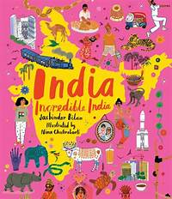
Places to visit:
Yateley Common Country Park:
The children will be able to be surrounded by the nature of the park, looking at the flowers, plants and animals that live there.
Local Area:
By visiting your local area, can you find out anything about its history to share with the class?
Things to make and do:
Fraction Nature Pizza: What You Need: A round log slice or large paper circle + natural items (leaves, pebbles, twigs).Activity: Divide the “pizza” into halves or quarters. Decorate each section with natural materials. Ask: "What fraction has leaves?" or "How many quarters have stones?“
Sound Walk: Take a walk and listen for natural sounds (birds, leaves, cars).Back at home, recreate the sounds using instruments or voices.
Year 2 Family Learning Ideas
The Natural World
Outdoor Learning:
The children could plant their own seeds, keeping a diary of simple measurements and drawing to record the progress. Also, they could write down what plants need to grow to record this.
Could you create a nature alphabet? When discovering your local area, could you find natural items shaped like letters, or collect objects that start with each letter of the alphabet?
Research Ideas and Books to Share:
‘Look and Wonder: The Amazing Plant Life Cycle Story’: This narrative non-fiction picture book explores the plant life cycle, from seed to tree, with vibrant illustrations and simple explanations.
‘India, Incredible India’: This book takes children on a visual journey across India, showcasing its landscapes, wildlife, and cultural landmarks through detailed illustrations.​

